Slide 1
A Test of Our Progress: Air Pollution, Social Justice and Covid Outcomes
TEAM MEMBERS:
Aissatou Diallo
Christine Kuta

Slide 2
Introduction
Pollution negatively affects health and well-being. Studies have found that economically and socially disadvantaged communities tend to be exposed to higher levels of pollution .
Communities exposed to higher levels of pollution are called environmental justice(EJ) communities.
The goal of the research is to find out whether environmental justice communities are particularly prone to poor covid outcomes.

Slide 3
Pollution
Air Pollutants
PM25
Harmful to health
Can worsen covid infection in victims
NOx
Has significant effects on becoming infected by the virus
OZONE
Can worsen covid infection in victims
Notes:
PM25 & Ozone speed up the harm caused by the infection

Slide 4
Environmental Justice
Broadly, environmental justice is the right to be protected from environmental hazards and to live in a clean environment.
The social and economic characteristics of Environmental justice communities have not been yet established.
Notes:
there is no commonly accepted precise definition of an EJ community in governmental agencies or in environmental or social justice groups
Studies have shown poorer people tend to be more prone to it than richer
Another paper mentioned all people of color regardless of their economic status are exposed to polluted areas compare to white people

Slide 5
Covid Deaths: Massachusetts Counties Case
The most polluted county, Middlesex County, did not have the highest covid mortality.
Poorer counties, for example, Hampden County, less polluted, had higher mortality rates.
COUNTY | POP-2019 | PM 25_AV | POOR | COVID_DEATHS TOTAL thru 2021 | DEATH RATE
Hampden | 469818 | 8.2 | 17.2 | 1859 | 0.0049
Bristol | 561483 | 6.9 | 12.2 | 2214 | 0.0039
Essex | 785205 | 7.8 | 10.9 | 2828 | 0.0036
Plymouth | 515142 | 7.2 | 8 | 1736 | 0.0034
Worcester | 826116 | 7.9 | 11.1 | 2672 | 0.0032
Berkshire | 126313 | 7.7 | 11.3 | 395 | 0.0031
Norfolk | 700322 | 8.1 | 6.5 | 1976 | 0.0028
Barnstable | 213444 | 6.7 | 7.5 | 608 | 0.0028
Middlesex | 1602947 | 8.5 | 8.2 | 4154 | 0.0026
Suffolk | 797939 | 7.6 | 19.6 | 2050 | 0.0026
Hampshire | 161834 | 8 | 13.8 | 368 | 0.0023
Franklin | 70702 | 7.7 | 10.9 | 151 | 0.0021
Nantucket | 11229 | 6 | 11.2 | 0 | 0
Dukes | 17325 | 6 | 8.4 | 0 | 0

Slide 6
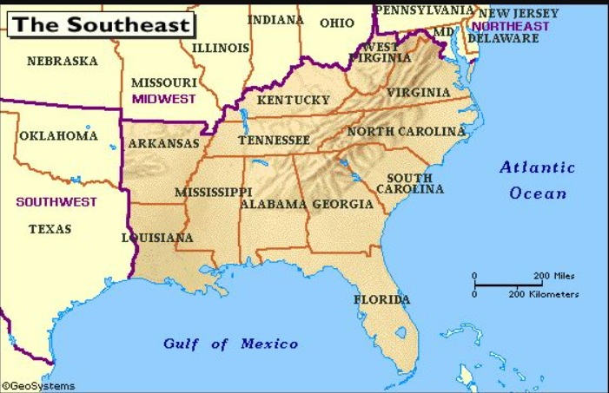
Target: US South East States

Slide 7
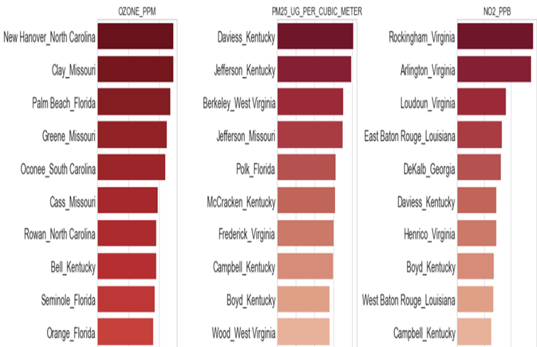
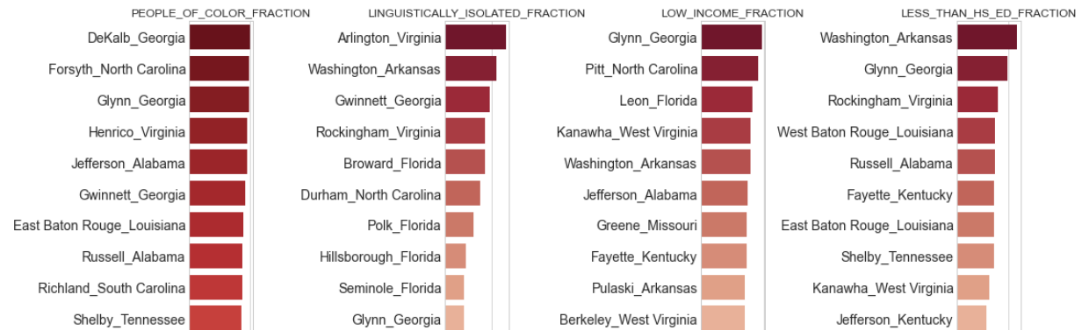
Pollution and EJ: South East US Counties Case
Most Polluted counties
Highly Challenged EJ Counties

Slide 8
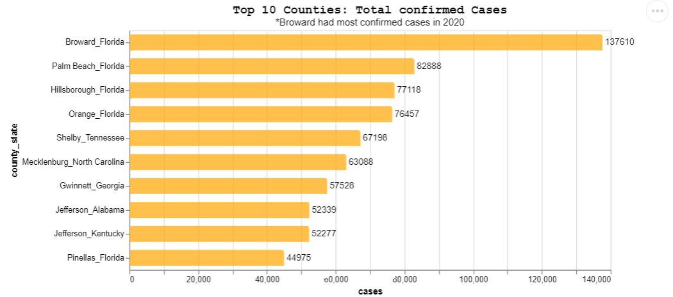
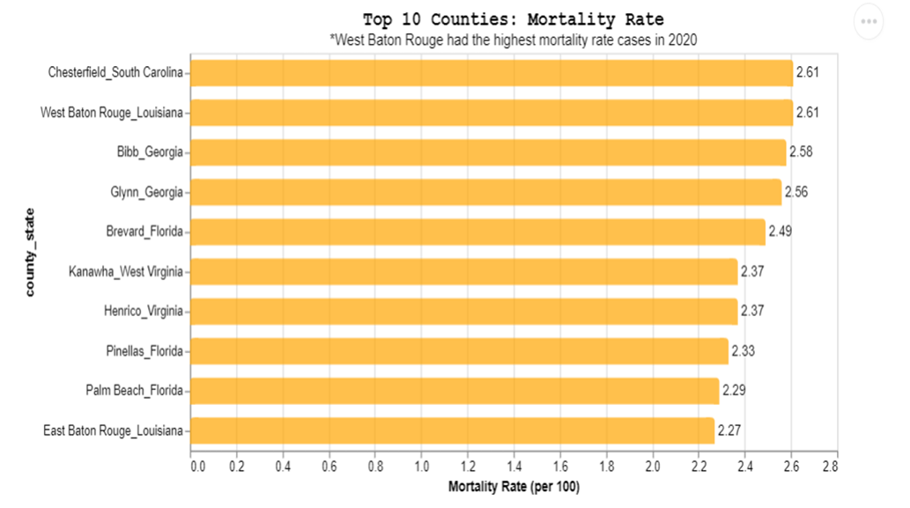
Covid Deaths Cntd: South East Counties Case
Most affected Counties
Counties With highest mortality rate

Slide 9


Most Polluted counties vs Most affected Counties
Most Polluted
Most Affectted

Slide 10


Highly Challenged EJ Counties vs Counties With highest mortality rate
Highly Challenged EJ Counties
Counties with highest mortality rate

Slide 11
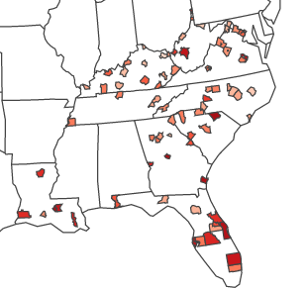
Covid Deaths Cntd: South East Counties Case
Being closer to the coast didn’t prevent high level of infection or death rate

Slide 12
For the Future (going forward)
Examine accuracy for the demographic data for the communities around the sensors.
Make use of the other existing sensors networks along with the EAP network
Do a further examination for common characteristics of the most polluted locations
Notes:
EAP sensors are mainly put on government buildings – other sensors network such as the purple ones can be added to it

Slide 13


